Slide 1

LIBRARY Management System
Group 16

Slide 2
Members
Ba9 -037 Nguyễn Hải Long 30%
Bi11-069 Lê Trần Khương Duy 40%
Bi11-101 Trần Việt Hoàng 10%
Bi11-234 Dương Nghĩa Quyết 5%
Ba10-058 Kim Nhật Thành 10%
Ba10-025 Nguyễn Thị Khánh Huyền 5%

Slide 3

TABLE OF CONTENTS
01
02
INTRODUCTION
STRUCTURE
03
04
DEMO
CONCLUSIONS
What, why,...
Classes, modules,...
Executing
Done!

Slide 4

01
INTRODUCTION

Slide 5
What ?
Library Management systems is a project to develop a program to maintain all the daily work of library.
Librarian modules are add new book, view all books, issue book, return book.

Slide 6
Library Management Purpose
Reduced the work for librarian
Faster retrieval of information about the book
All detail be available on a click
Provide better and efficient services
Easy to management books resources

Slide 7
3.How ?

Slide 8


02 STRUCTURE
Classes
Modules
Packages
DB diagram

Slide 9

DATABASE

Slide 10
C. Database Diagram
book_issued
bid: varchar(30)
Name: varchar(30)
issuedDate: text
e_returnDate: text
returnDate: text
fine: float
bid: varchar(20)
title: varchar(30)
author: varchar(30)
status: varchar(30)
memberinfo
books
bid: varchar(20)
Issuedto: varchar(30)

Slide 11
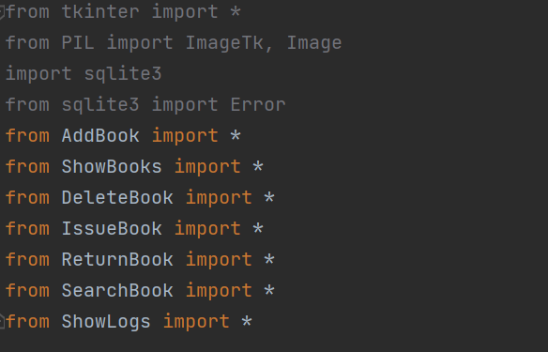
a.Packages and modules
main.py
We use 3 packages (for all functions) + 7 modules are functions with sqlite3.connection.

Slide 12
Modules
5. IssueBook.py 6. ReturnBook.py 7. SearchBook.py 8. Show issue/return logs
1. main.py 2. AddBook.py 3. DeleteBook.py 4. ShowBooks.py

Slide 13
1. AddBook.py
Getting and Storing new books data into the database 2 methods: addbook() & add_book_query()

Slide 14
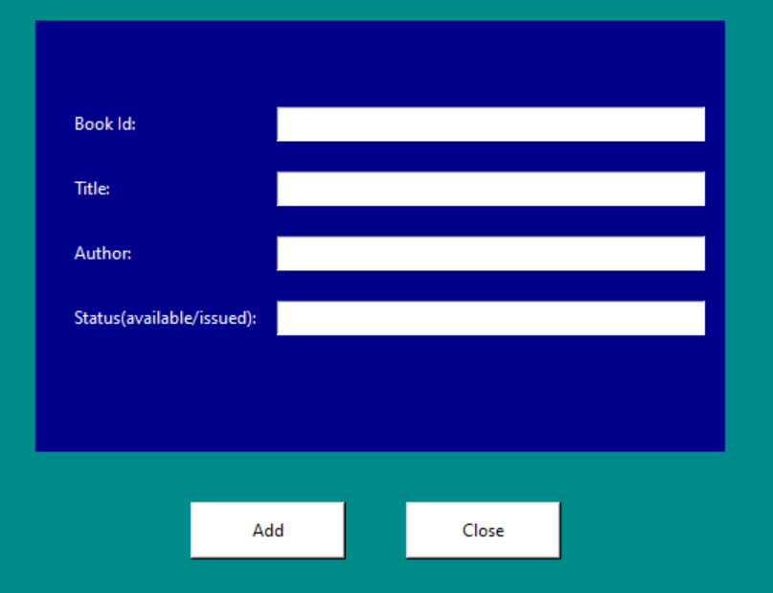
1. AddBook.py
addbook(): Create GUI for user input

Slide 15
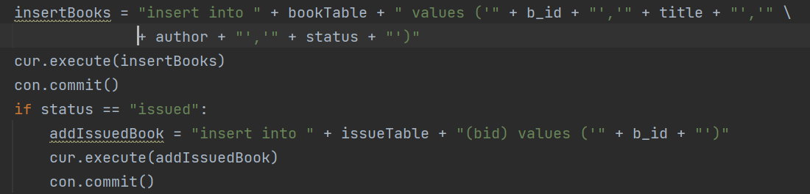
1. AddBook.py
add_book_query(): store given data into database by execute necessary queries

Slide 16
2. DeleteBook.py
Delete a book data from all tables 2 methods: delete() & delete_book_query()

Slide 17
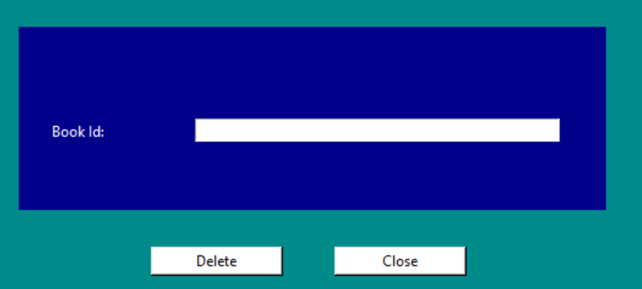
2. DeleteBook.py
delete(): create Gui for user input

Slide 18
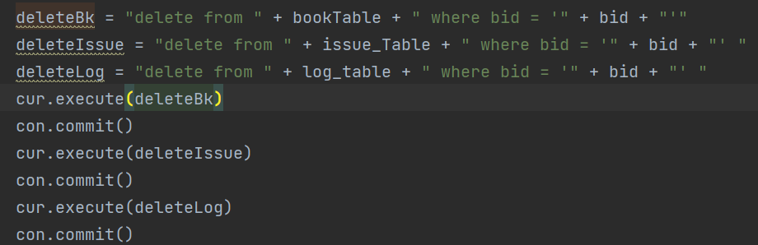
2. DeleteBook.py
Delete_book_query(): delete book data that match given book ID from database

Slide 19
3. ShowBooks.py
Show data of all books from the table books in the database 1 methods: show_books()

Slide 20
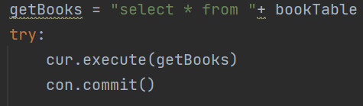
3. ShowBooks.py
show_books(): get all data in table books and using GUI to show

Slide 21
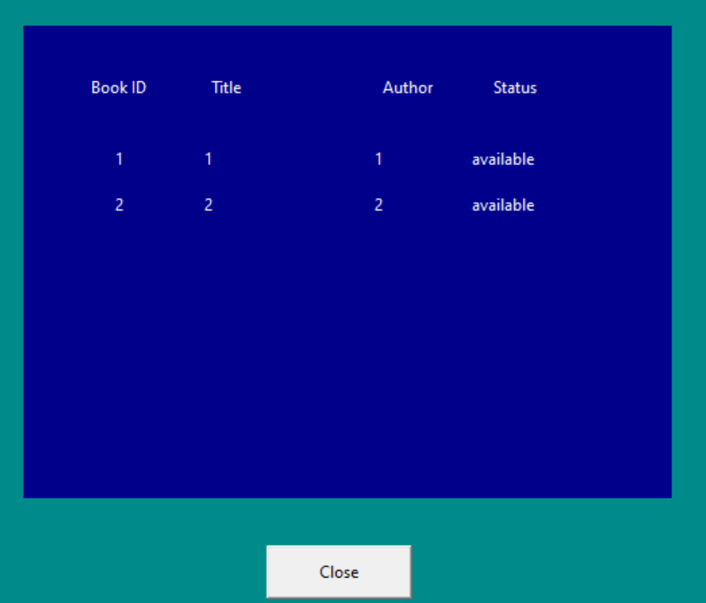
3. ShowBooks.py
show_books(): get all data in table books and using GUI to show

Slide 22
4. IssueBook.py
Issue book to people and update book status on the database 2 methods: issuebook() & issue_book_query()

Slide 23
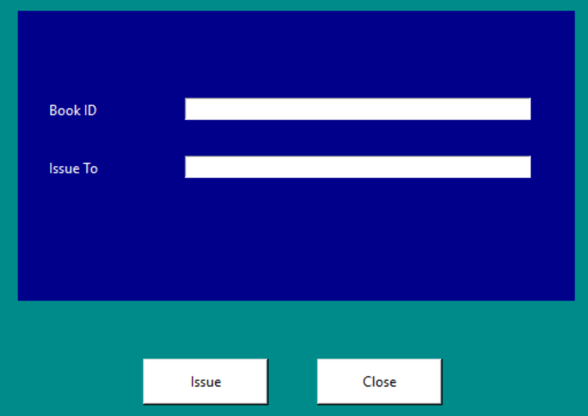
4. IssueBook.py
Issuebook(): create GUI for user input

Slide 24
4.IssueBook.py
Issue_book_query()
1. Search book data on table books by given ID then change its status from “available” to “issued”. If the book is already issued, a message will be prompt. 2. Add input book ID and borrower name to table books_issued and memberInfo 3. Get the current date when issuing is done and store it as issue date and add 1 week to issueDate and store it as expected return date table memberInfo.

Slide 25
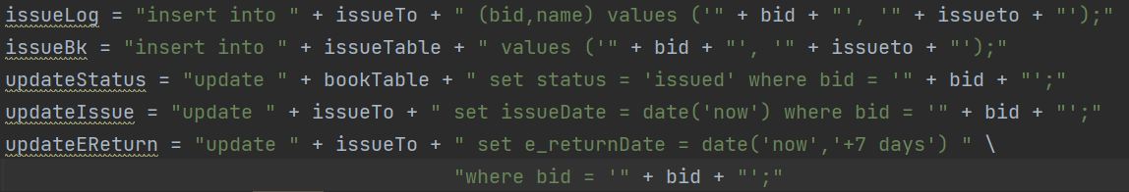
4.IssueBook.py
Issue_book_query()

Slide 26
5.ReturnBook.py
Return issued books and change it status on database 2 methods: returnbook() & return_book_query()

Slide 27
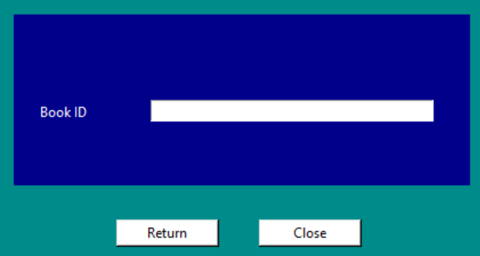
5.ReturnBook.py
returnBook(): create GUI for user input

Slide 28
5.ReturnBook.py
return_book_query()
1. Delete all data of the book that match given book ID from table books_issued. 2. Update status of that book on table books from “issued” to “available”. If it’s already available, a message will be prompted. 3. Get the current date when returning is done and store it as return date in table memberInfo 4. Calculate the difference in day between return Date and expected return Date, times 2 and store it as fine in table memberInfo

Slide 29
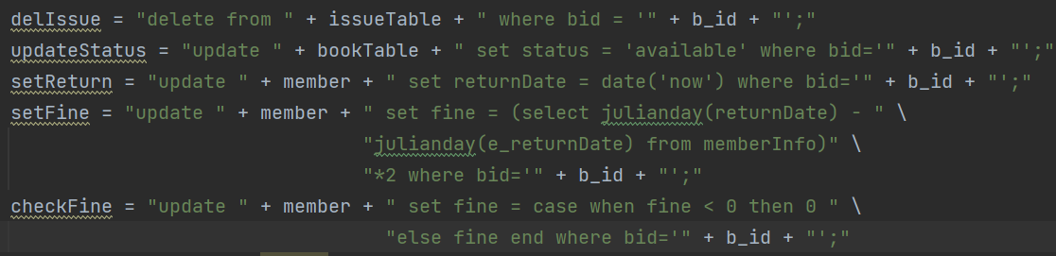
5.ReturnBook.py
return_book_query()

Slide 30
6.SearchBook.py
Search and get data of a specific Book based on its ID 2 methods: search() & search_book_query()

Slide 31
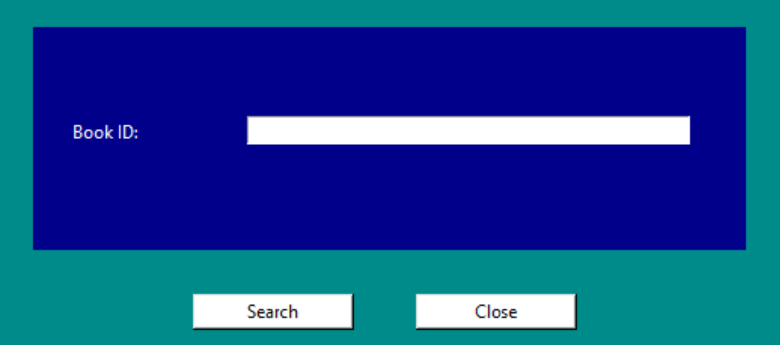
6.SearchBook.py
search(): create Gui for user input

Slide 32
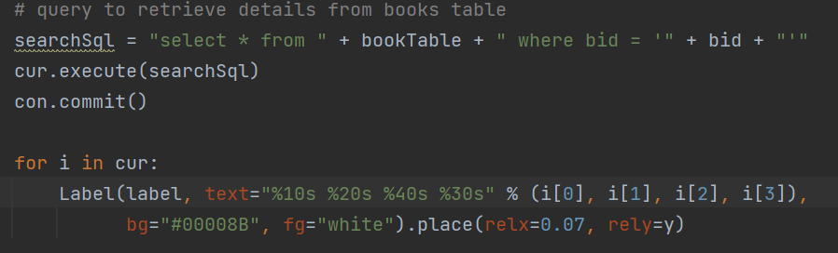
6.SearchBook.py
search_book_query(): Search book based on ID on table books and show

Slide 33
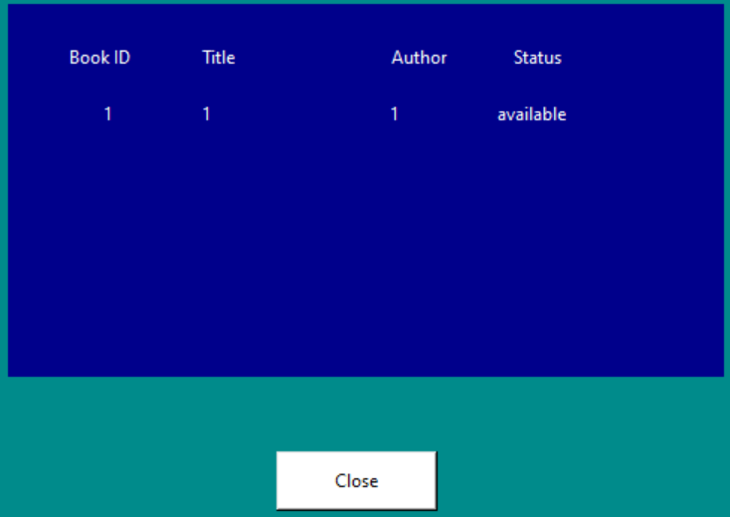
6.SearchBook.py
search_book_query(): Search book based on ID on table books and show

Slide 34
7.ShowLogs.py
Show issue/return logs by showing data from table memberInfo 1 method: Show_Log()

Slide 35
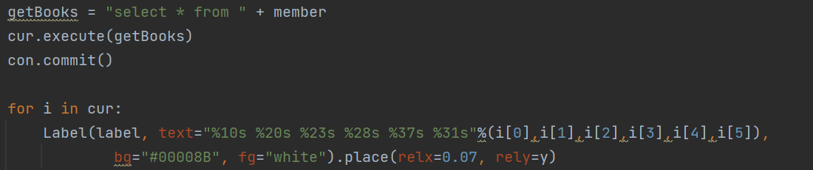
7.ShowLogs.py
Show_Log(): Getting all data from table memberInfo and print it

Slide 36
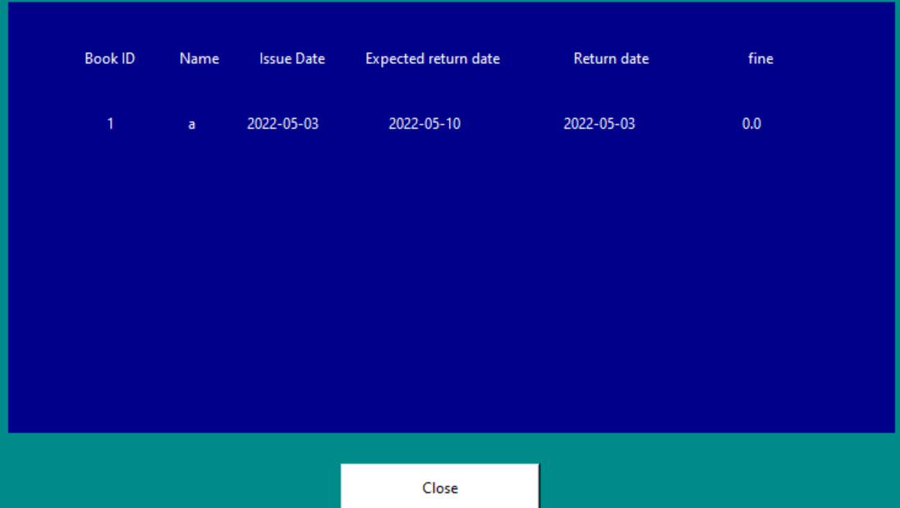
7.ShowLogs.py
Show_Log(): Getting all data from table memberInfo and print it

Slide 37
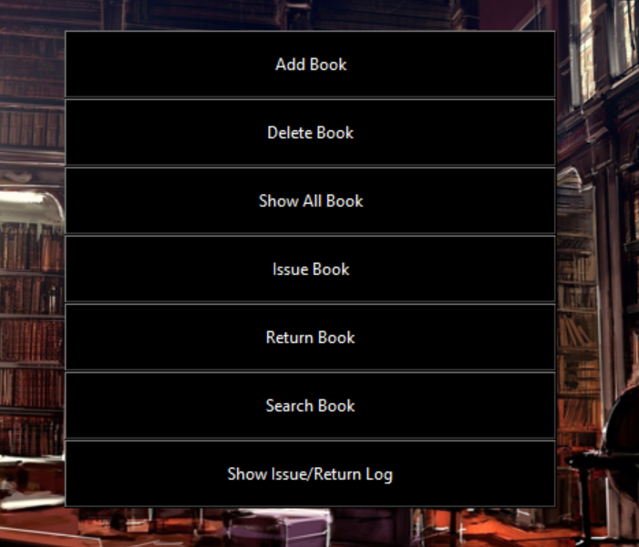
8.main.py
Create a menu with various buttons which can call its associated feature

Slide 38
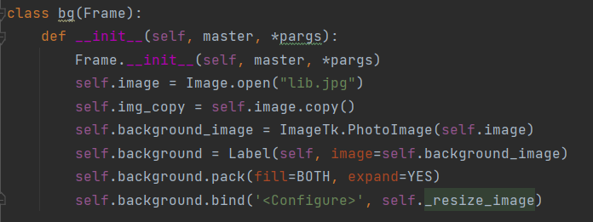
1 class : bg (Frame)
Has GUI with methods : AddBook, DeleteBook, ViewBooks, IssueBook, returnBook, SearchBook, ShowIssue.
b . Classes and Methods

Slide 39
B.1 : book Register() : fill all the fields (id, title, author, status) create data for one book.
B.2: deleteBook() : Delete one book data.
B.3: View(): Show all data.
B.4: issue (): information for book issued, reissued, unreturned.
B.6: return(): Notice of paid titles, more information, and archives
B.7: searchBook(): In searching data, we can find by id , each book has unique id.
b . Classes and Methods

Slide 40

03 DEMO

Slide 41

04 CONCLUSIONS
Advantages
Drawbacks
Provide basic functions for a library
Lack of security, require a login, logout feature and saving accounts part.
GUI Format could have been improved more.
Done!

Slide 42
GITHUB LINK
https://github.com/DuyLe0912/Group-16-Project.git

Slide 43


